Slide 1
Virtual Brown Bag: New F&A Procedures
Presented April 6, 2020

Slide 2
Agenda
Checks
ACH letter
Saving ACH/Wire Requests in SharePoint
Naming Convention
Saving Credit Card Statements in SharePoint
Saving Requests for Funding in SharePoint
Naming Convention

Slide 3
Checks
Effective March 16, 2020, Partners of the Americas will process all payments electronically.
Vendors, employees, volunteers, contractors, etc.
Via ACH (domestic) or wire (international)
To contact vendors, volunteers, contractors, etc., the following ACH letter can be used as a resource to collect bank information.

Slide 4

ACH Letter
This Photo by Unknown Author is licensed under CC BY

Slide 5
Saving ACH/Wire Requests in SharePoint
All payment requests should be submitted electronically to the following directory:
C:\Partners of the Americas\F&A – Organizational F&A\Finance Payment Requests
Within this directory, there are subfolders:
One for each program unit (CPU, EDH, EGC)
Membership
BizDev & Comm
Admin, HR & IT.

Slide 6
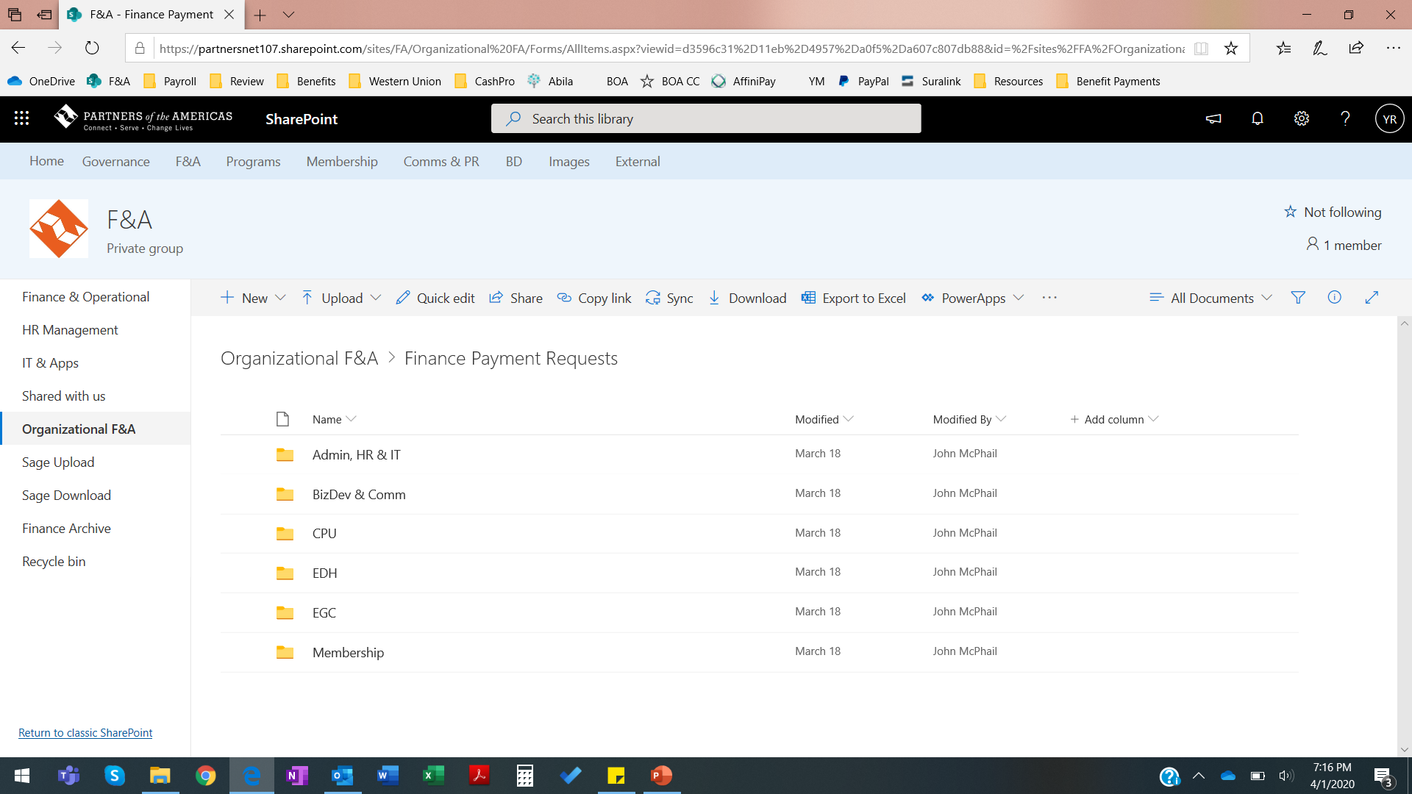

Slide 7
Saving ACH/Wire Requests in SharePoint
Signed payment request form and its supporting documents must be saved in the corresponding program/unit folder.
Electronic signatures as well as e-mail authorized requests are acceptable.
For each individual request, either of the following is acceptable:
A single PDF file with the request form and its supporting documents
A subfolder with the request form and its supporting documents

Slide 8
Naming Convention for Payment Requests
The following naming convention must be followed for either the PDF file or subfolder:
Unit name - Payment Type - Brief name of recipient – year-month-month day to be processed
Examples:
CPU Wire Bejarano 2020-03-31
Admin ACH Keystone 2020-03-31

Slide 9
Reminder
Finance stops retrieving submitted payment requests after the 8:00 AM cutoff time for processing.
Any submitted requests received after the cutoff time will be processed in the next disbursement cycle.
Please refer to the current payment calendar for more information!

Slide 10
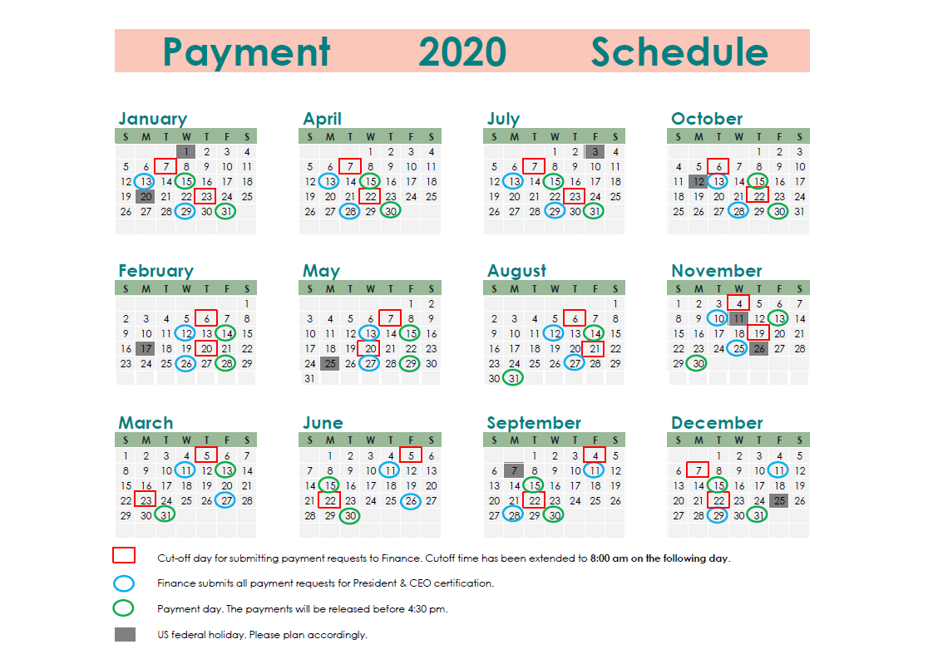

Slide 11
Saving Credit Card Statements in SharePoint
Applicable to current credit card users
Receiving their monthly statements from F&A
Credit card statements from the user should be submitted electronically to the following directory:
C:\Partners of the Americas\F&A – Organizational F&A\Finance Credit Card Submissions
Subfolders will be created for each staff submission. Please save the following in your appropriate folder:
Cover sheet (signed by both submitter and approver)
Excel file of the cover sheet
Supporting documents (e.g. receipts)
Once submitted, please send an email notification to the Finance team.

Slide 12
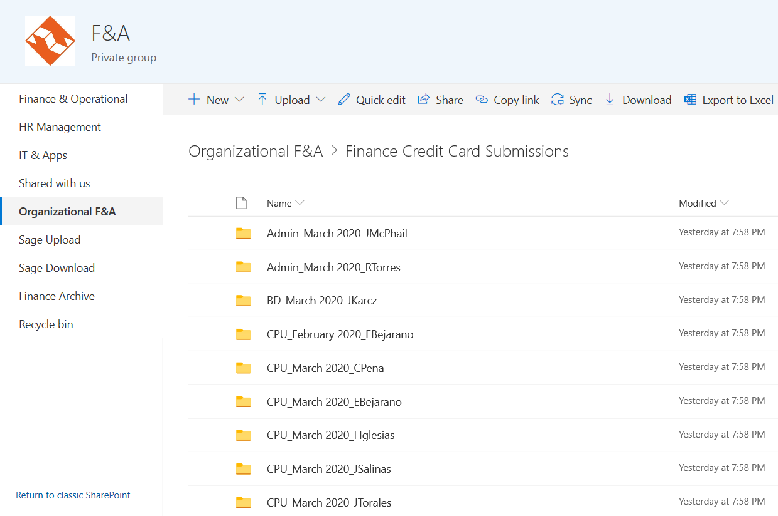

Slide 13
Saving Requests for Funding in SharePoint
Requests for funding should be submitted electronically to the following directory:
C:\Partners of the Americas\F&A – Organizational F&A\Finance Funding Requests
Within this folder, there are monthly subfolders. Please save the following in the appropriate folder:
Signed funding request
Only electronic signatures are accepted for this type of transaction.
Supporting documents

Slide 14
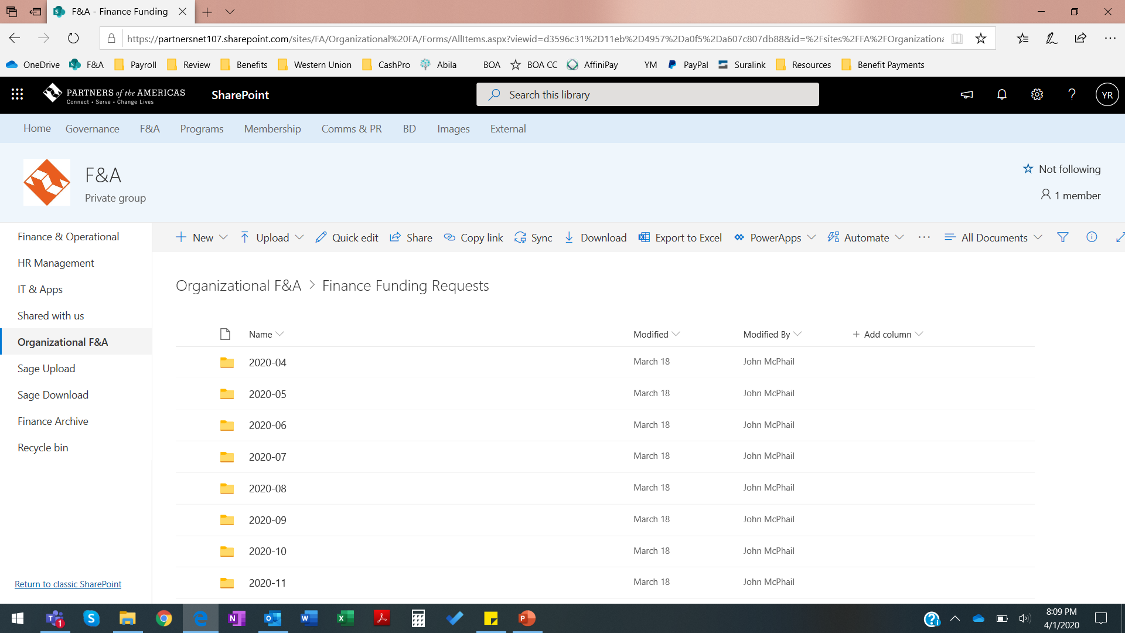

Slide 15
Naming Convention for Funding Requests
For each individual request, either of the following is acceptable:
A single PDF file with the request form and its supporting documents
A subfolder with the request form and its supporting documents
The following naming convention must be followed for either the PDF file or subfolder:
Project code - year – month
Examples:
DOL419 2020-04
USAID619 2020-05

Slide 16

Reminder
Requests for funding are due to the Finance team on the 21st of each month.

